Slide 1

Northern Arizona University
Concrete Canoe
Presentors:
Cristopher Aguilar
Stephanie Croker
Katrina Shurley
Michael Schubert
Matthew Vigil

Slide 2


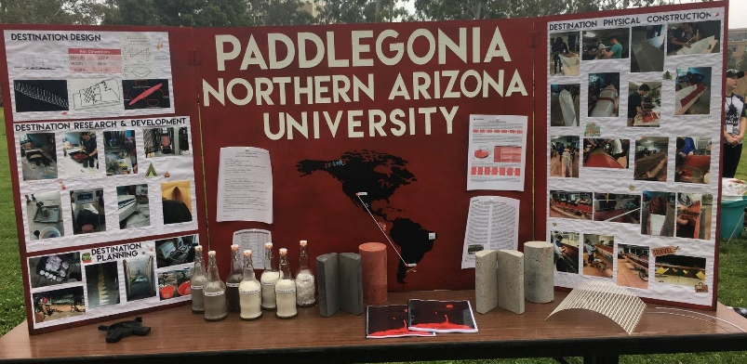
Concrete Canoe
Concrete Canoe Competition
PSWC 2017 at UC Irvine
April 6 – 8, 2017
Conference Deliverables
Final Product
Racing Placement
Design Paper
Oral Presentation
Figure 1: Concrete Canoe Racing
Figure 2: Concrete Canoe Display

Slide 3
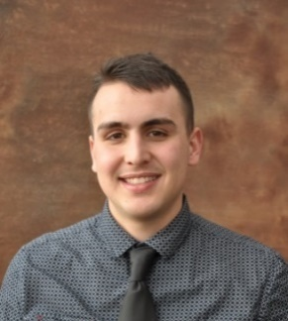
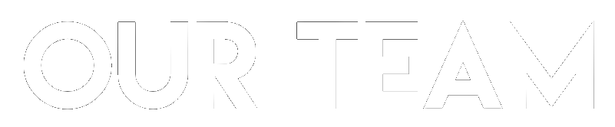

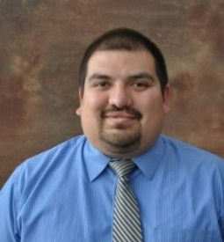

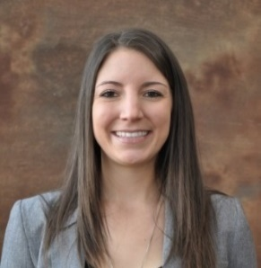
Project Manager
Matthew Vigil
Constraints
$5000 Budget
Local Materials
NCCC Rules
Impacts
NAU & ASCE Reputation
Further Institutional Knowledge
Project Engineer
Katrina Shurley
Materials Engineer
Michael Schubert
Reinforcement Engineer
Cristopher Aguilar
Structural Engineer
Stephanie Croker
Figure 3: Team Organization

Slide 4
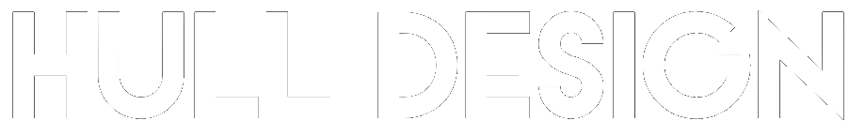
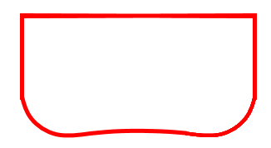
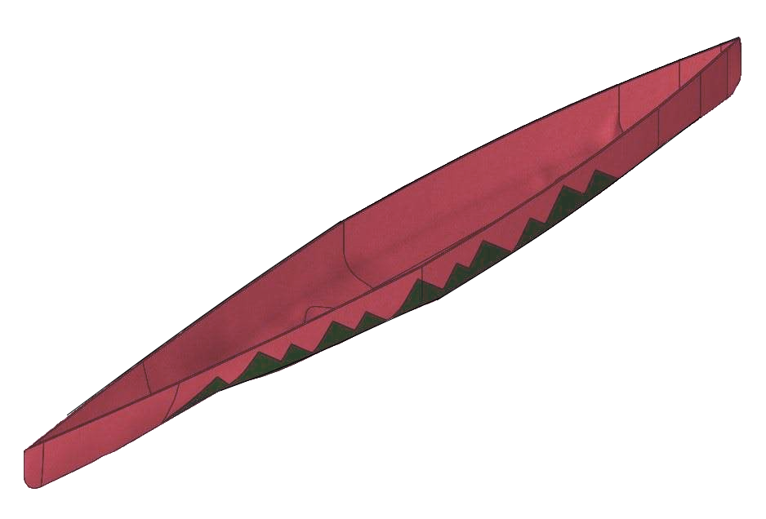

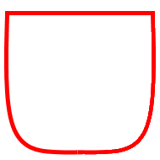
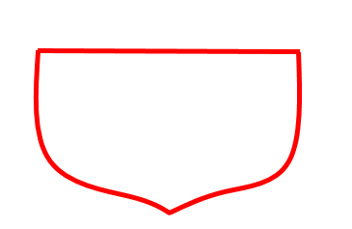
Table 1: Canoe Dimensions
Hull Dimensions
Length | 252 in
Width | 28 in
Height | 16 in
Shallow Concave Bottom
Flat Bottom
V-Shape
Curved Keel Sailboat
Figure 4: Hull Shape

Slide 5
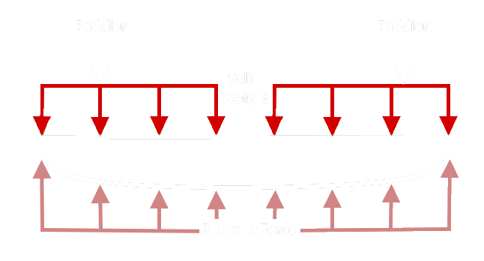
Example Loading
Figure 5: Free Body Diagram Example

Slide 6
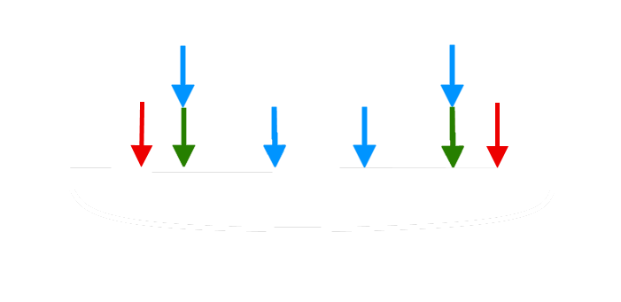
Loading Scenarios
2 person closest to bow and stern
2 person racing
4 person racing
Figure 6: Loading Scenarios

Slide 7
Shear Diagram
Moment Diagram
Figure 7: Shear Diagram
Figure 8: Moment Diagram

Slide 8
Table 2: Stress Results
Scenario | Tensile Stress (psi) | Compressive Stress (psi)
Closest To Bow and Stern | 32.2 | 83.6
2-Person | 34.4 | 13.3
4-Person | 102.5 | 39.5

Slide 9

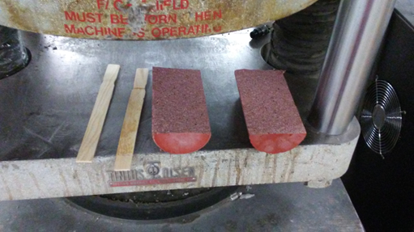
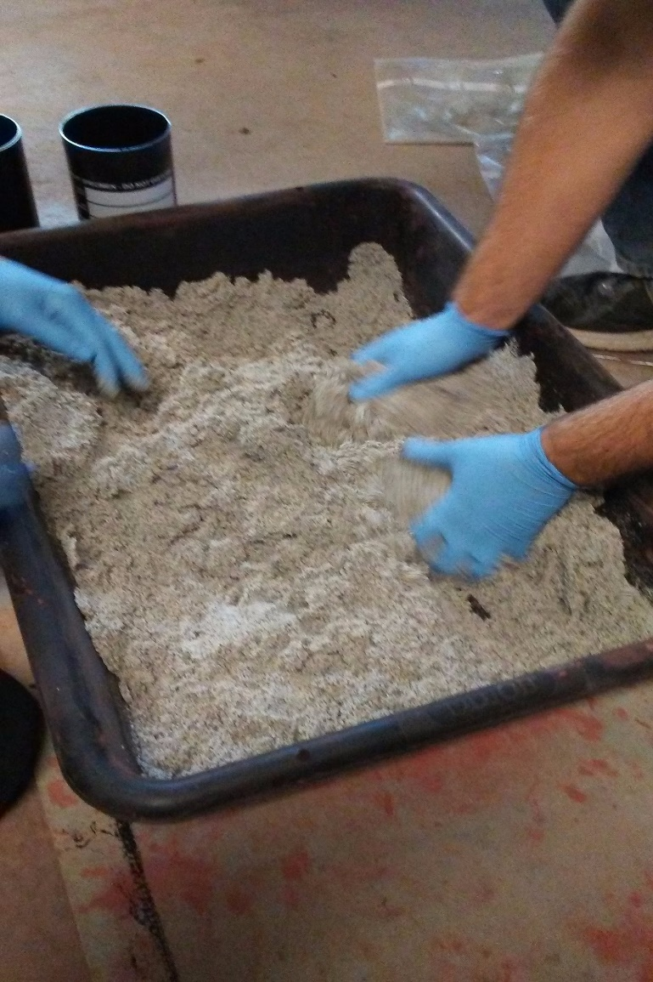
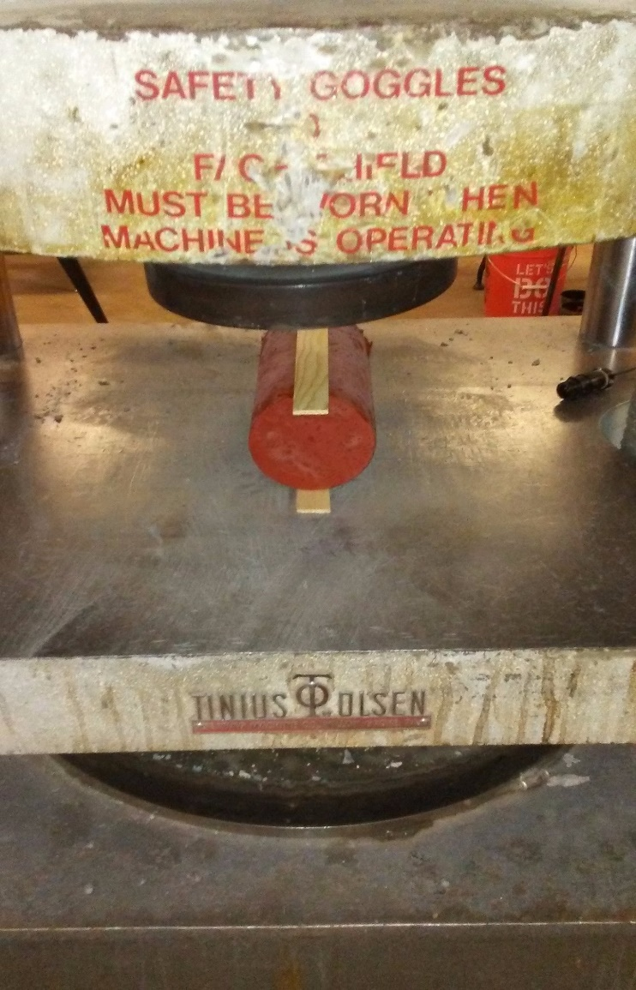
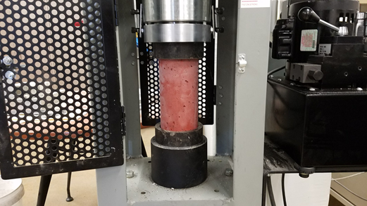
Figure 11: Split Tensile Result
Figure 9: Hand Mixing
Figure 10: Split Tensile Set-up
Figure 12: Compression Testing

Slide 10
Table 3: Concrete Mix Matrix
Mix Designation | Unit Weight (lb/ft³) |  | Air Content | Strength (psi)
 | Wet (Plastic) | Oven-Dried |  | Compressive | Tensile | Flexural
50% Fly Ash (Large Mixer) | 85 | 72 | 1.0% | 3167 | 225 | 400
50% Fly Ash (Paddle Mixed) | 78 | 70 | 3.7% | 2287 | 225 | 400
50% Fly Ash (SSD-Paddle Mixed) | 74 | 69 | 3.7% | 2263 | 225 | 400
50% Fly Ash (SSD-Hand Mixed) | 70 | 67 | 3.7% | 2196 | 225 | 400
70% Fly Ash (SSD -Hand Mixed) | 60 | 55 | 9.6% | 1547 | 190 | 250
30% Fly Ash (SSD-Hand Mixed) | 65 | 60 | 11.0% | 1850 | 200 | 750
30% Fly Ash (SSD-Hand Mixed) Colored | 76 | 63 | 19.0% | 3257 | 290 | N/A
Primary Reinforcements: |  | Fiberglass Mesh or Basalt Mesh
Secondary Reinforcements: |  | BASF M-100 Microfibers

Slide 11
Table 4: Structural Mix Results
Table 5: Finishing Mix Results
Structural Mix
Wet Unit Weight | 60.3 lb/ft³
Oven-Dry Unit Weight | 53.9 lb/ft³
28-Day Compressive Strength | 1939.0 psi
28-Day Tensile Strength | 218.1 psi
28-Day Flexural Strength | 827.4 psi
Concrete Air Content | 11%
Finishing Mix
Wet Unit Weight | 77.8 lb/ft³
Oven-Dry Unit Weight | 64.8 lb/ft³
28-Day Compressive Strength | 3547.0 psi
28-Day Tensile Strength | 321.9 psi
Concrete Air Content | 19%

Slide 12

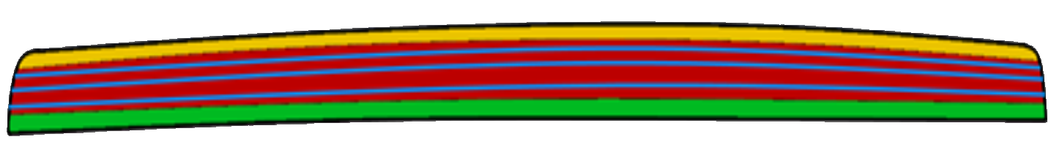
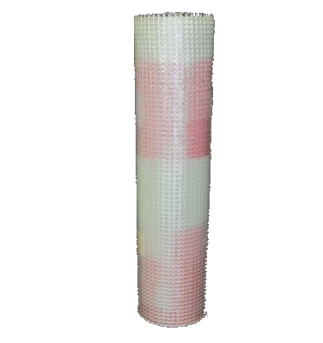
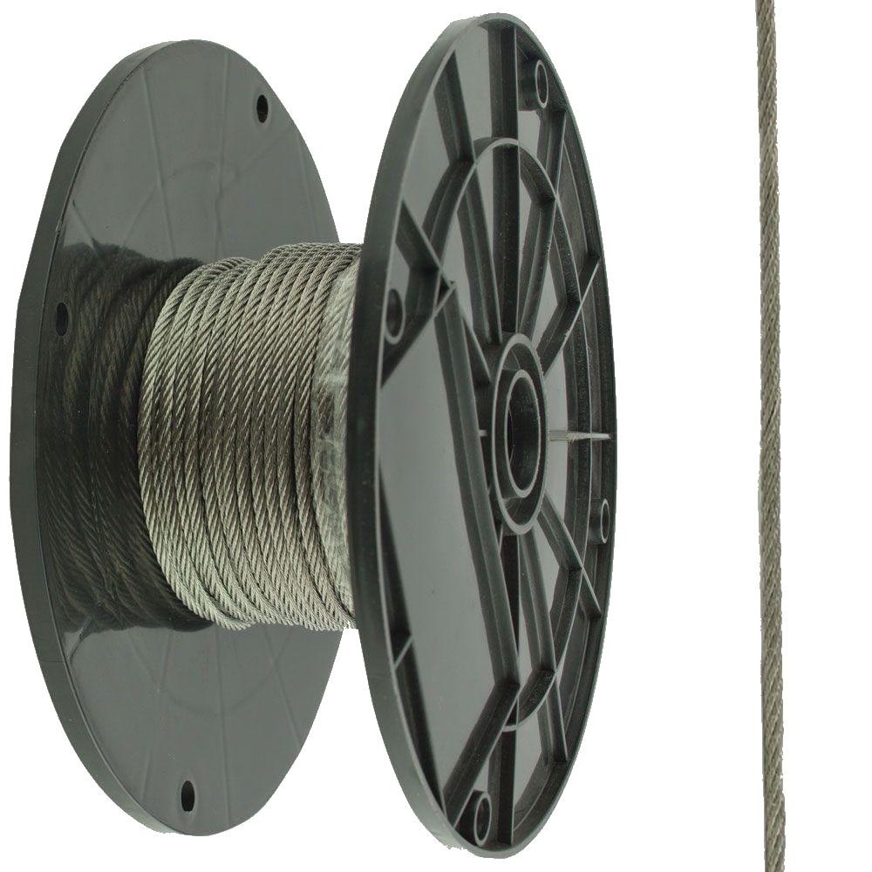
Percent Open Area Calculations
Materials
SpiderLath Fiberglass Mesh
1/16” Galvanized Steel Wires
Figure 13: Schematic of Mesh Placement: (yellow - keel) (blue - post-tensioning wires) (red - wall of canoe) (green - gunwale)
Figure 14: Reinforcement Materials

Slide 13
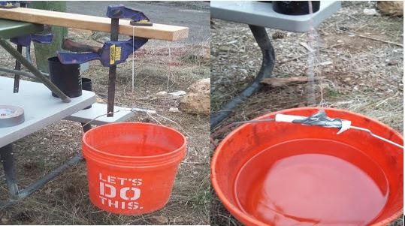
Table 6: Mesh Test Results
SpiderLath Material | Strength (lb)
Last Year’s Material | 28.80
New Material | 30.13
Weighted Strand
Yielding Strand
Figure 15: Mesh Testing

Slide 14
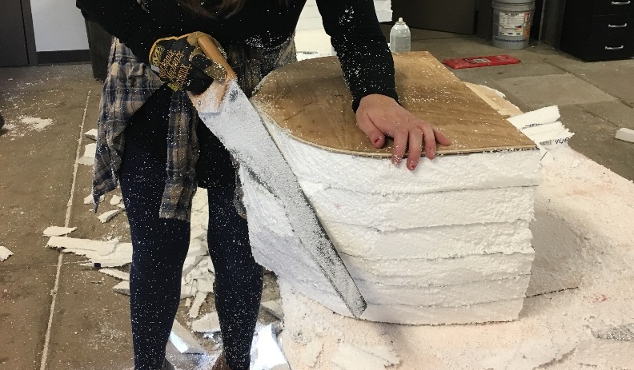
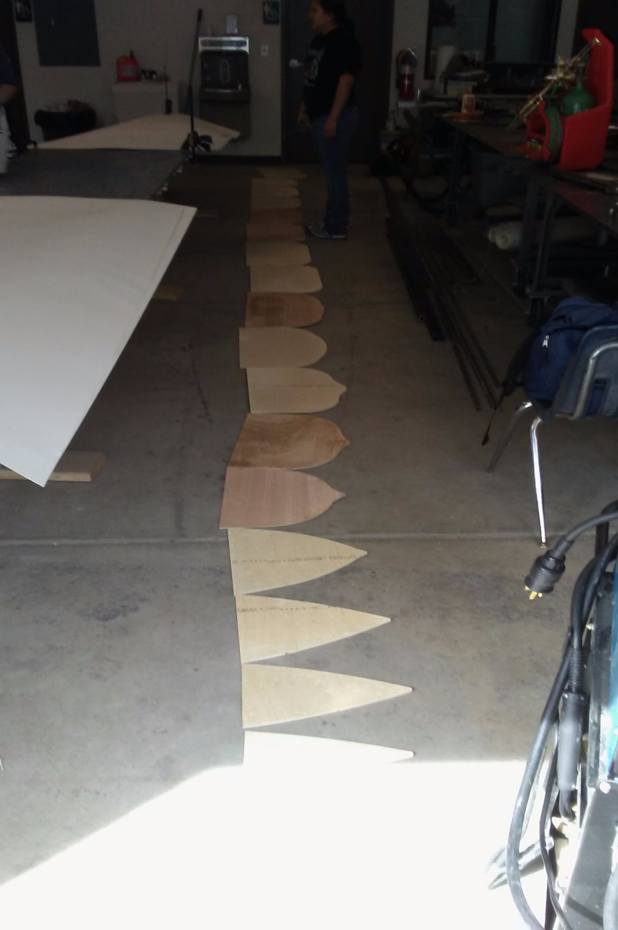
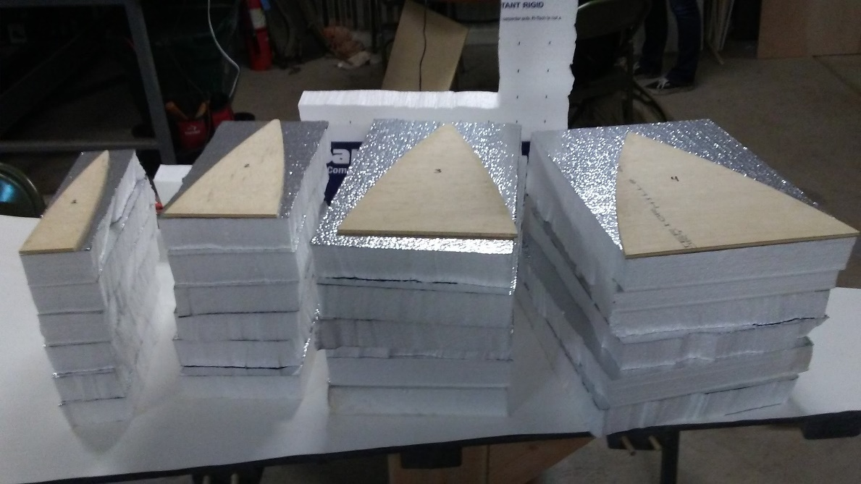
Figure 17: Cross-section & Foam Sheets
Figure 18: Mold Cutting
Figure 16: Water-Jet Cut Cross-sections

Slide 15
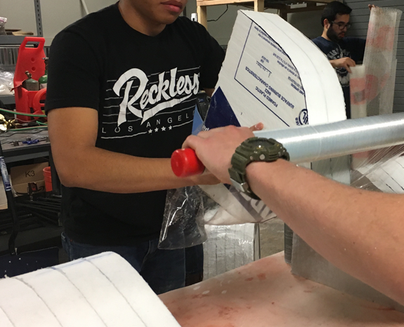
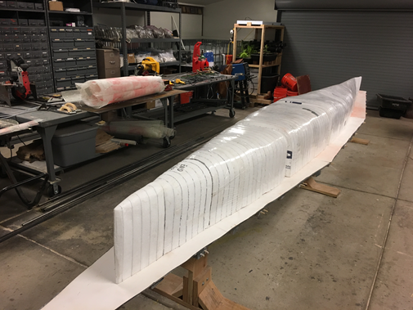
Figure 19: Shrink-wrapping
Figure 20: Canoe Mold

Slide 16
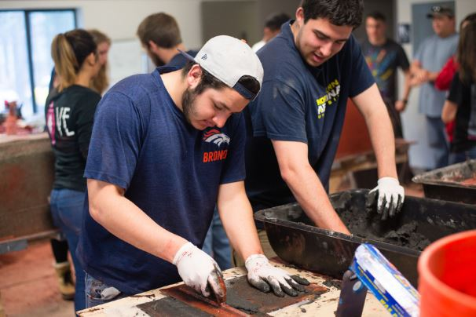

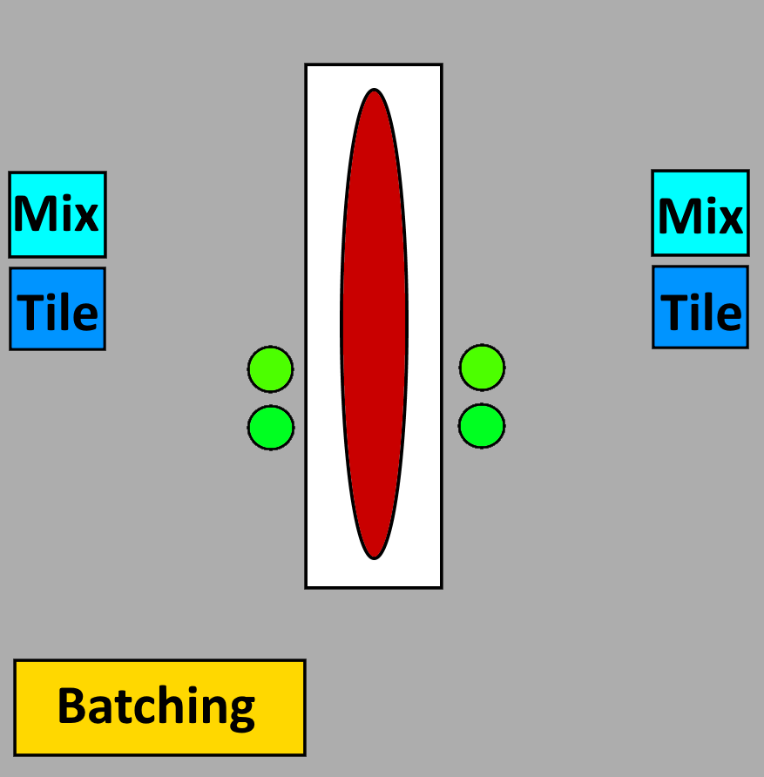
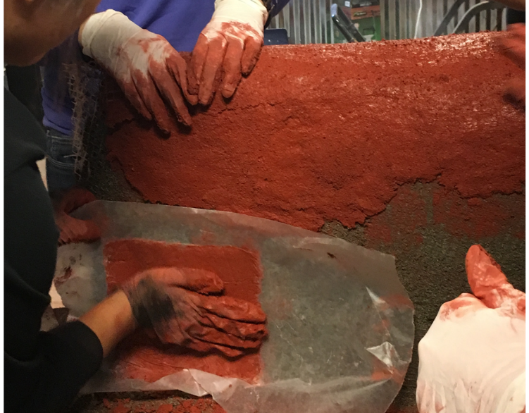
Figure 22: Mix and Tile
Figure 23: Tile Placement
Figure 21: Pour Day Layout

Slide 17
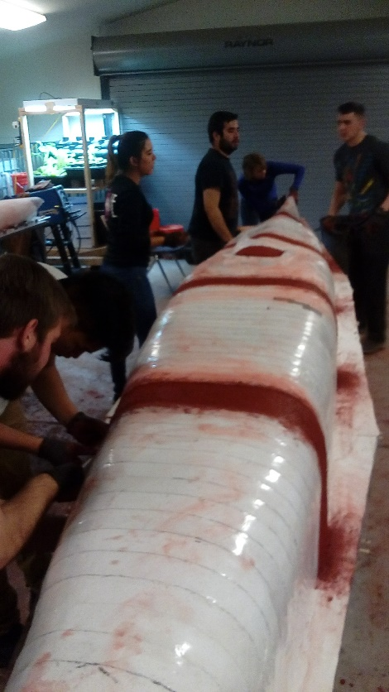
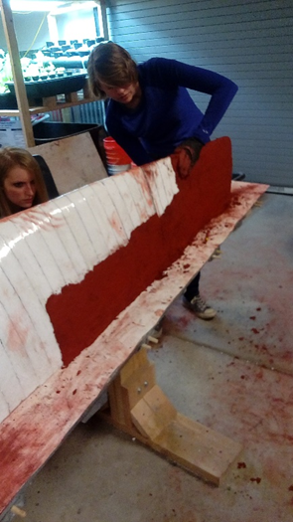
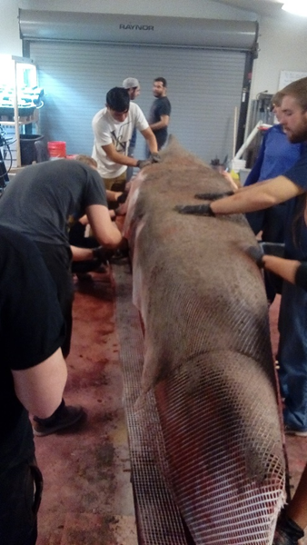
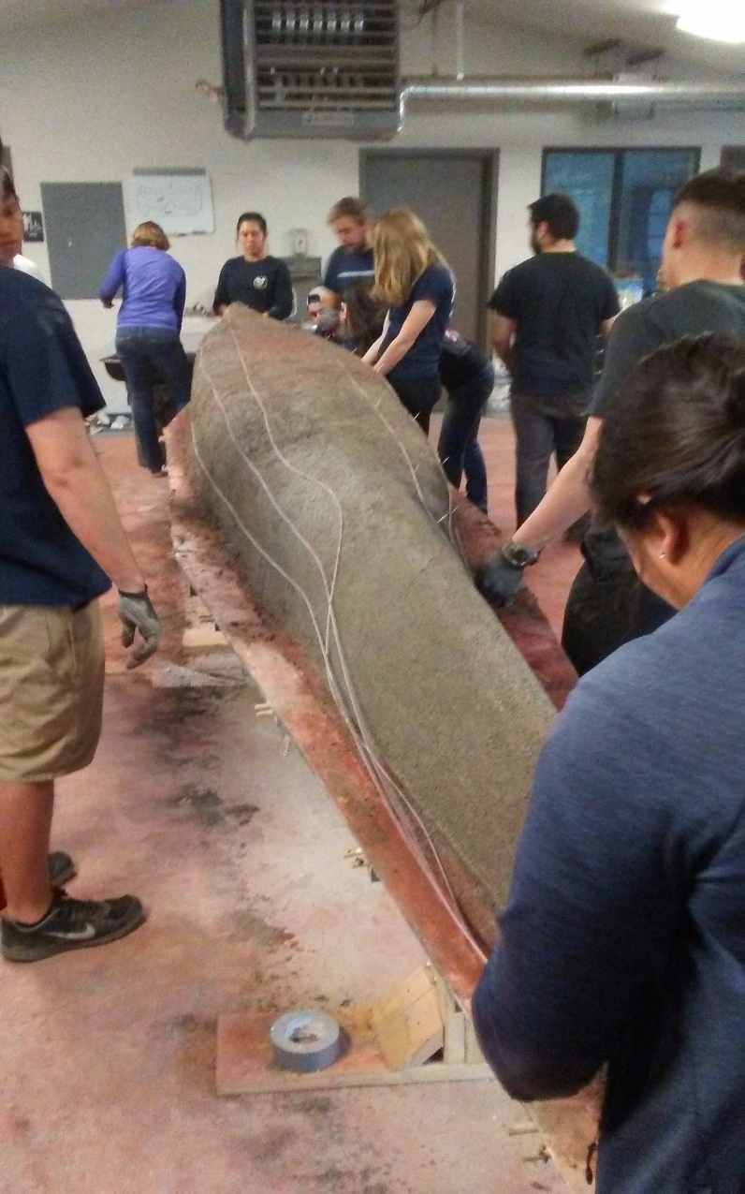
Figure 24: Rib Fill
Figure 25: First Layer Placement
Figure 26: Second Layer Placement
Figure 27: Post-tension Placement

Slide 18
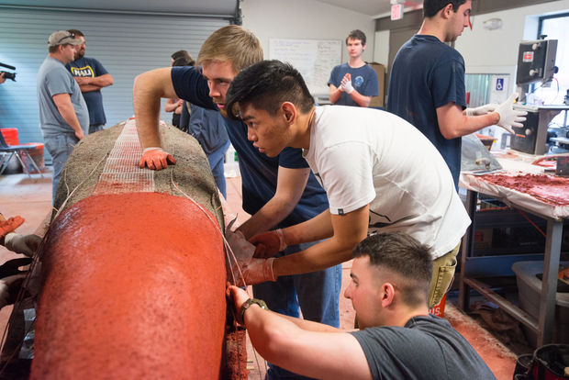
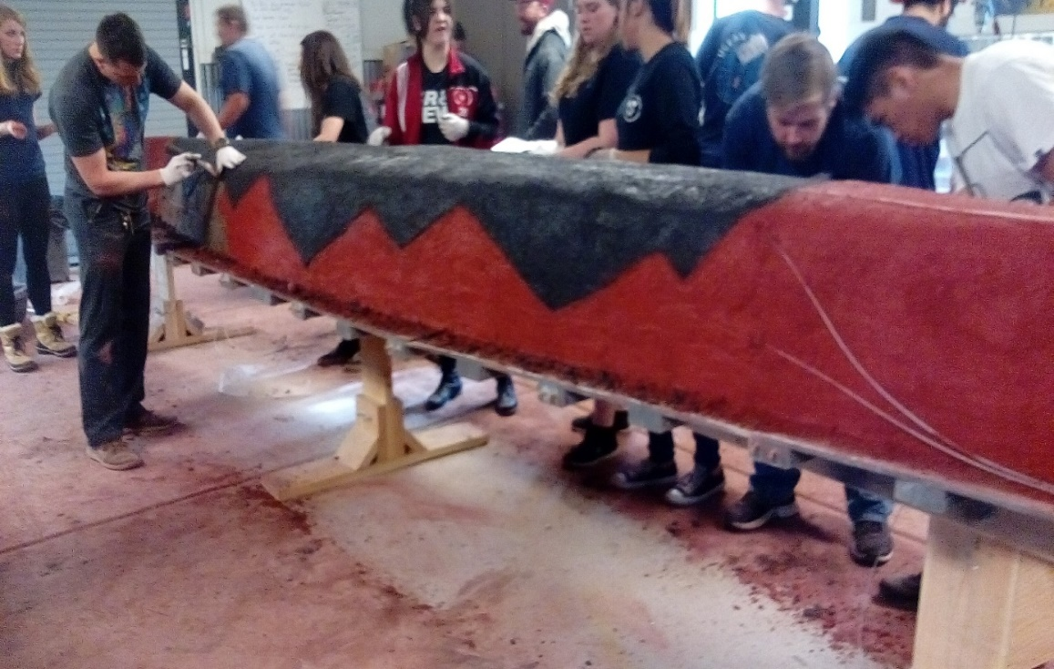
Figure 28: Third Layer Placement
Figure 29: Final Placement

Slide 19
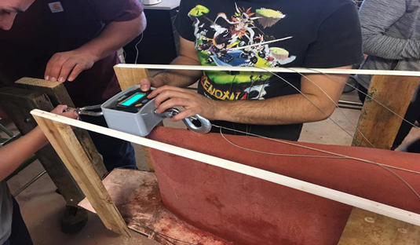

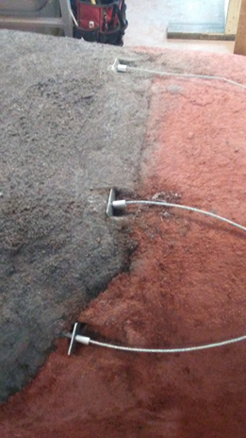
Figure 31: Post-tension Force Measurement
Table 7: Post-tension Results
Wires | Applied (lb) | Calculated (lb) | Actual (lb)
Top | 100 | 80 | 80
Middle | 100 | 70 | 70
Bottom | 100 | 70 | 70
Figure 30: Post-tension Fasteners

Slide 20
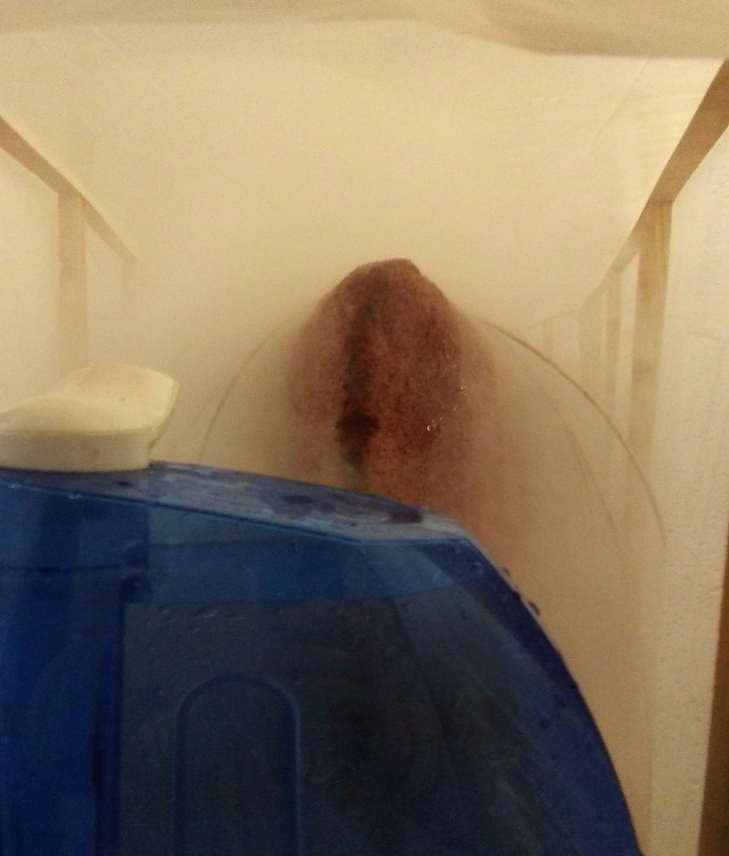

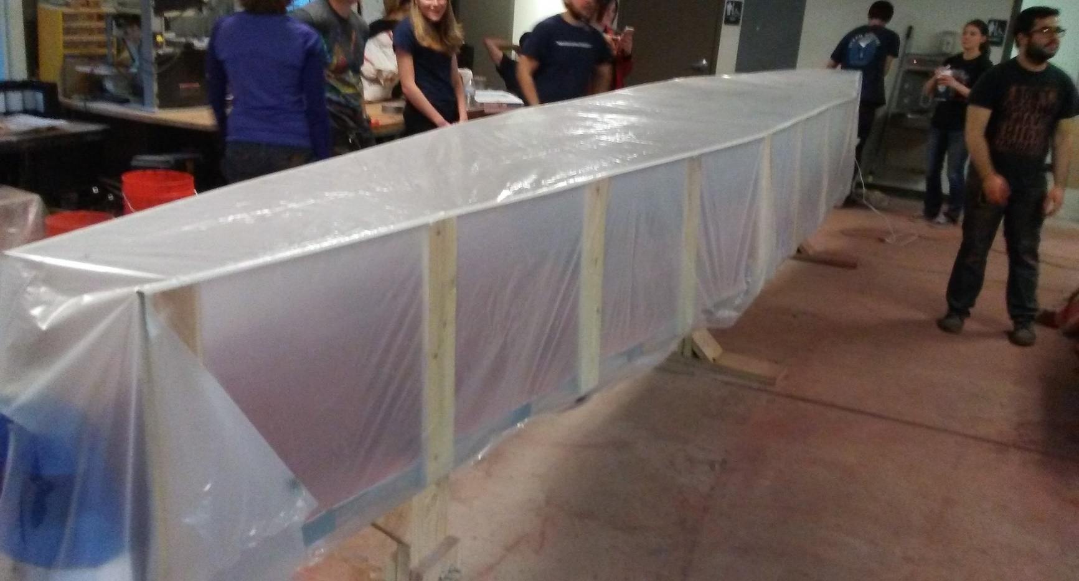
28-Day Moist Cure
70 Degrees Fahrenheit
95% Relative Humidity
Reusable Curing Chamber
Figure 32: Chamber Humidity
Figure 33: Curing Chamber

Slide 21
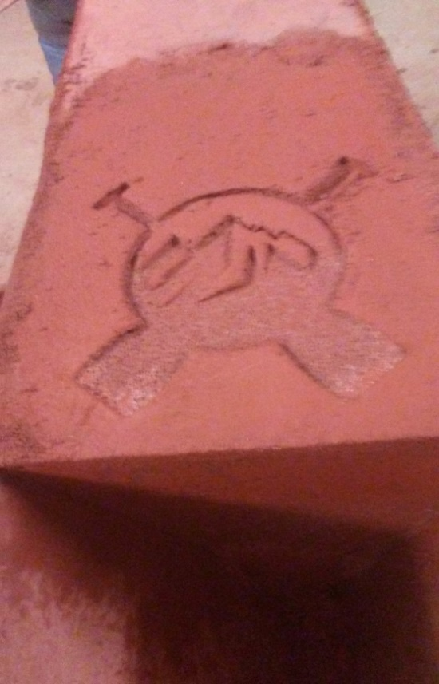
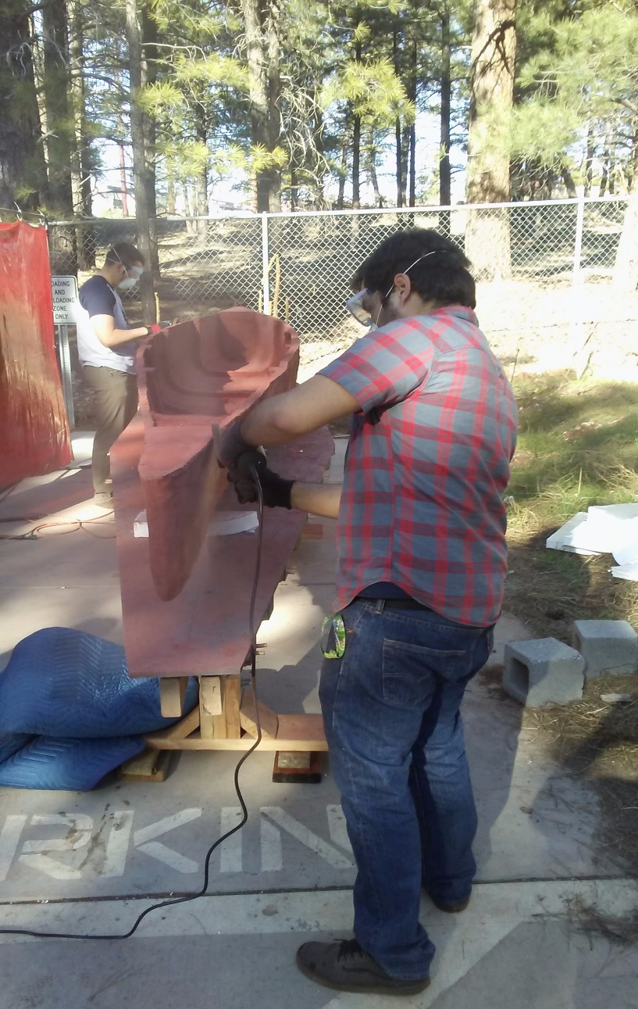
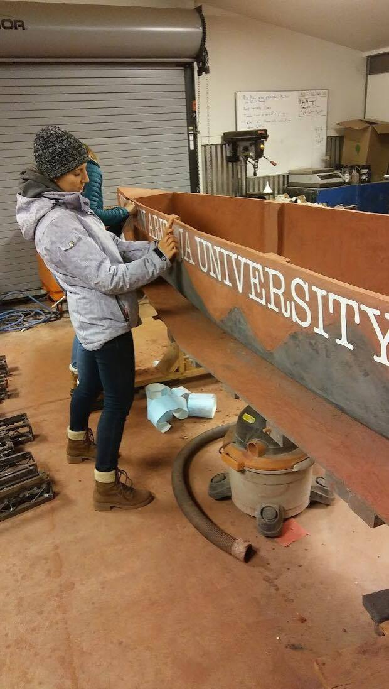
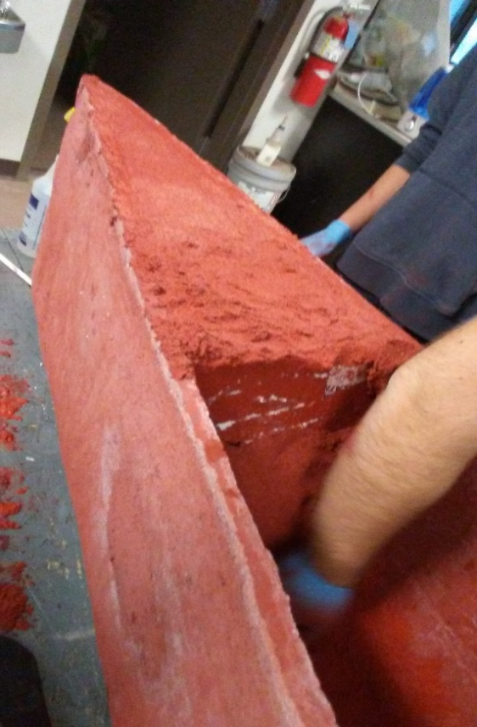
Figure 34: End-cap Covering
Figure 35: Logo Impression
Figure 36: Canoe Sanding
Figure 37: Vinyl Lettering & Sealer

Slide 22
Table 8: Conference Results
Event | Placement
Product Display | 7th
Racing | 14th
Design Paper | 6th
Oral presentation | 6th
Overall | 8th
State Champs!

Slide 23

Table 9: Schedule
Task Name | Scheduled End Date | Actual End Date
Project Management & Fundraising | 12/3/17 | 4/14/17
Analysis and Design | 12/31/17 | 2/17/17
Testing | 12/31/17 | 1/15/17
Mold Construction | 1/20/17 | 2/18/17
Canoe Construction | 1/21/17 | 2/18/17
Canoe Curing | 2/18/17 | 3/18/17
Finishing | 3/26/17 | 4/4/17
Paddling Practice | 4/5/17 | 4/5/17

Slide 24

Figure 38: Person Hour Breakdown

Slide 25

Table 10: Cost of Engineering Services
1.0 Personnel | Classification | Rate ($/hr) | Projected Hours | Projected Cost | Actual Hours | Actual Cost
 | PM | 144 | 98 | $14,112.00 | 98 | $14,112.00
 | SE | 84 | 97 | $8,148.00 | 97 | $8,148.00
 | RE | 80 | 112 | $8,960.00 | 112 | $8,960.00
 | ME | 81 | 102 | $8,262.00 | 102 | $8,262.00
 | PE | 82 | 122 | $10,004.00 | 122 | $10,004.00
 | EIT | 61 | 125 | $7,625.00 | 125 | $7,625.00
 | INT | 23 | 160 | $3,680.00 | 210 | $4,830.00
 | TE | 51 | 197 | $10,047.00 | 247 | $12,597.00
 | Total Personnel |  |  | $70,838.00 |  | $74,538.00
2.0 Travel | Conference Travel | N/A |  | $282 |  | $200.00
 | Vehicle Rental | N/A |  | $480 |  | $400.00
 | Hotel | N/A |  | $600 |  | $4,338.00
3.0 Subcontract | Mold Construction | N/A |  | $1,000 |  | $0.00
4.0 Materials |  |  |  | $5,000 |  | $5,000,00
5.0 Lab & Equipment Fees |  | 100 | 197 | $19,700 | 215 | $21,500.00
5.0 Total |  |  |  | $97,900.00 |  | $105,976.00

Slide 26

Table 11: Cost of Materials
Material | Quantity | Unit Cost | Total Price
Gray Portland Cement Type I | 57 lbs | $0.05 | $2.57
Fly Ash, Class F | 26 lbs | $0.02 | $0.61
Trinity lightweight #1 Sand | 41 lbs | $0.05 | $2.05
Poraver 0.1 - 0.5 mm | 20 lbs | $0.70 | $14.00
Poraver 0.5 - 1.0 mm | 24 lbs | $0.70 | $16.80
Poraver 1.0 - 2.0 mm | 20 lbs | $0.70 | $14.00
MasterSet Delvo | 0.3 lbs | $1.39 | $0.42
MasterGlenium 7500 | 1.3 lbs | $1.78 | $2.31
MasterLife SRA 20 | 0.1 lbs | $4.31 | $0.43
MasterAir AE 90 | 0.01 lbs | $1.03 | $0.01
MasterColor (Medium Red, Black) | 11 lbs | $5.58 | $61.38
SpiderLath Fiberglass Mesh | 110 ft² | $0.77 | $84.70
1/16" Galvanized Steel Cable | 150 ft | $0.26 | $39.00
1/8" Nylon Tubing | 150 ft | $0.23 | $34.50
13/64" Zinc-Plated Copper Button Stops | 12 EA | $0.04 | $0.48
1/8" x 1/8" x 1" Steel Bearing Plates | 12 EA | $1.00 | $12.00
MasterFiber M100 Microfibers | 1.15 lbs | $8.15 | $9.37
2" x 4' x 8' R-Tech Foam Sheet for Floatation | 2 EA | $20.65 | $41.30
Foam Mold Construction | Lump Sum | $713.67 | $713.67
Bulk Head Element | 1 EA | $20.00 | $20.00
Rotating Steel Plate | 4 EA | $1.00 | $4.00
Vinyl Lettering | Lump Sum | $81.00 | $81.00
Sealer | 0.75 GAL | $48.50 | $36.38
 |  | Total | $1,190.98

Slide 27

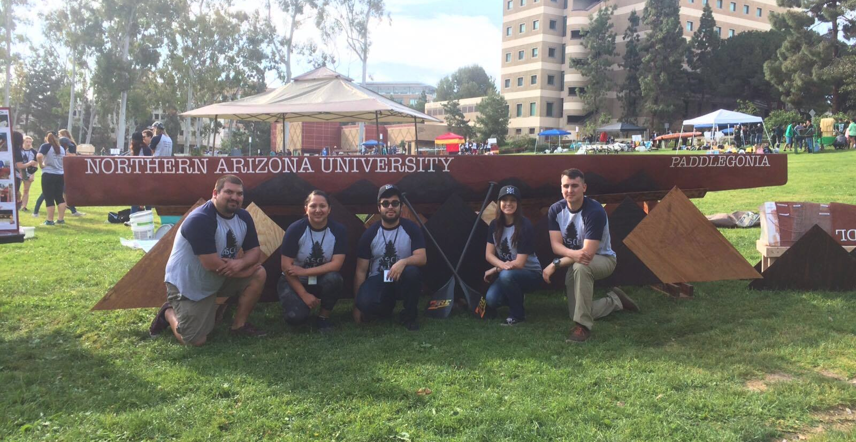
PSWC - 8th Place
Figure 39: Conference Display

